Slide 1
19CSE305: MACHINE LEARNING

Slide 2
KNN Algorithm
K-Nearest Neighbor Algorithm

Slide 3
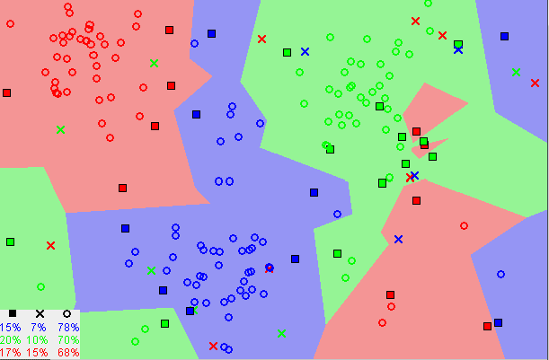
KNN-Algorithm
Supervised machine learning algorithm that can be used to solve both classification and regression problems
Assumes that similar things exist in close proximity (similar things are near to each other)
KNN captures the idea of similarity (sometimes called distance, proximity, or closeness)
“Birds of a feather flock together.”

Slide 4
KNN-Algorithm
Lazy learning algorithm − KNN is a lazy learning algorithm because it does not have a specialized training phase and uses all the data for training while classification.
Non-parametric learning algorithm − KNN is also a non-parametric learning algorithm because it doesn’t assume anything about the underlying data.

Slide 5
KNN-Algorithm
1. Load the data
2. Initialize K to your chosen number of neighbors’ and normalize the data.
3. For each example in the data
3.1 Calculate the distance between the query example and the current example from the data.
3.2 Add the distance and the index of the example to an ordered collection
4. Sort the ordered collection of distances and indices from smallest to largest (in ascending order) by the distances
5. Pick the first K entries from the sorted collection
6. Get the labels of the selected K entries
7. If regression, return the mean of the K labels
8. If classification, return the mode of the K labels

Slide 6
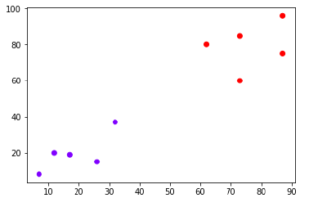
KNN-Algorithm
Example:
Suppose we have a dataset which can be plotted as follows −

Slide 7
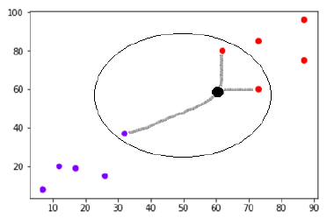
KNN-Algorithm
Example:
Now, we need to classify new data point with black dot (at point 60,60) into blue or red class. We are assuming K = 3 i.e. it would find three nearest data points.

Slide 8
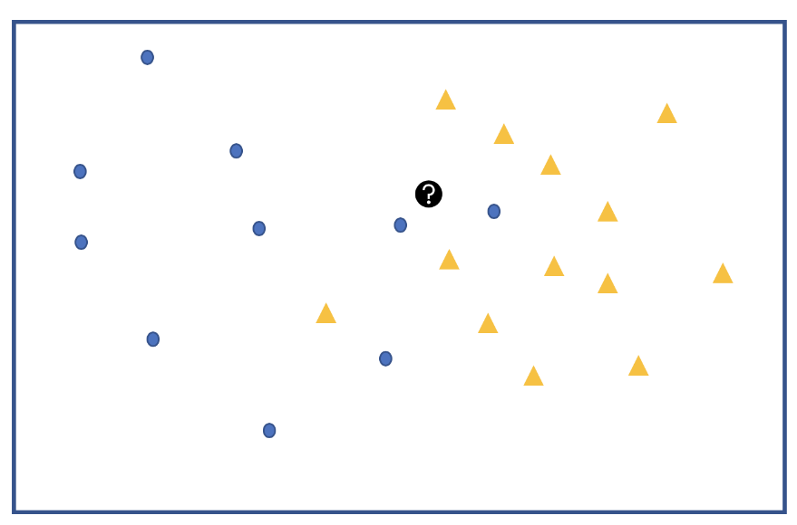
How to choose K?
Example:
Let’s say we have two groups of points —blue-circles and orange-triangles. We want to classify the Test Point = black circle with a question mark, as either a blue circle or an orange triangle.

Slide 9
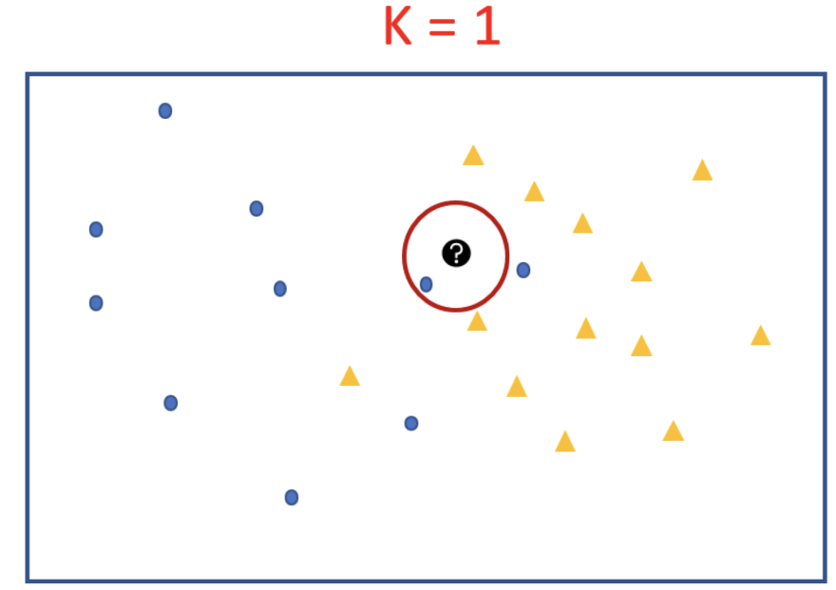
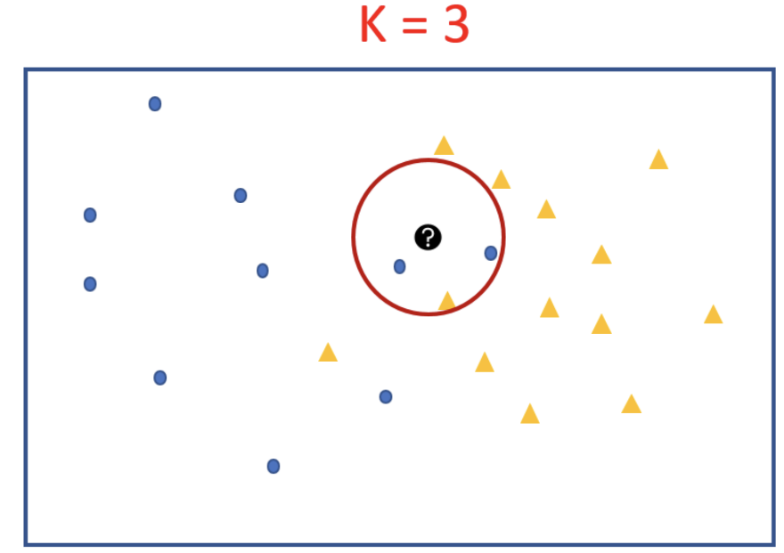
How to choose K?
For K = 1 we will look at the first nearest neighbor. Since we take majority vote and there is only 1 voter we assign its label to our black test point. We can see that the test point will be classified as a blue circle for k=1.

Slide 10
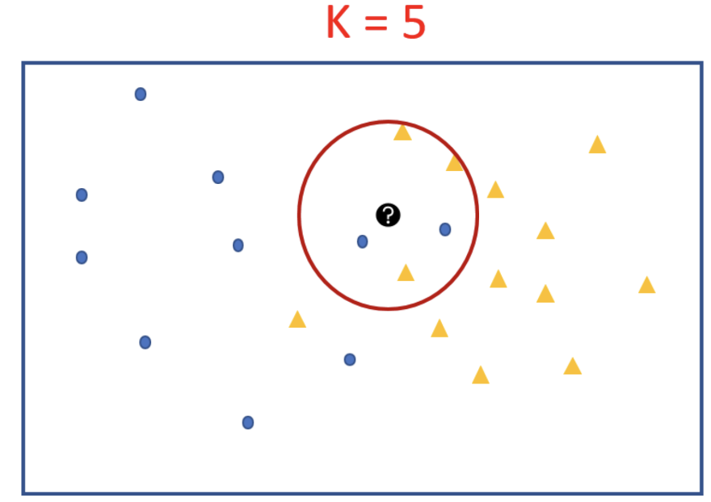
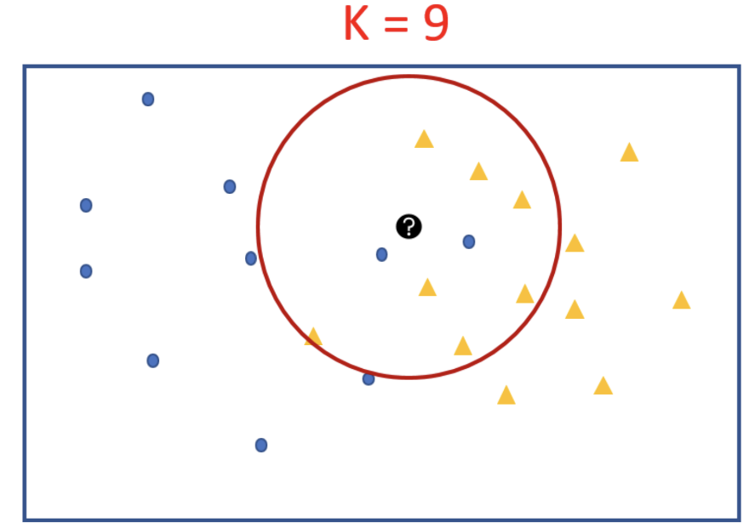
How to choose K?

Slide 11
How to choose K?
If K is very Large: The class label of the majority class of the training data set will be assigned to the rest data regardless of the class labels of the neighbours nearest to the test data.
If K is very Small: The class value of a noisy data/outlier in the training dataset which is the nearest neighbor to the test data will be assigned to the test data.
The best value of K is somewhere between these to extremes.
Set K = square toot of the number of training records.
Test several K values on a variety of test data sets and choose the one that gives best performance.

Slide 12
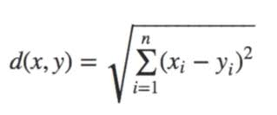

KNN-Algorithm
Distance Measures
Euclidean Distance
Manhattans Distance

Slide 13
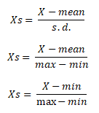
KNN-Algorithm
Standardization

Slide 14
KNN-Algorithm
PROS
Easy to understand
No assumptions about data
Can be applied to both classification and regression
Works easily on multi-class problems
CONS
Memory Intensive / Computationally expensive
Sensitive to scale of data
Struggle when high number of independent variables

Slide 16
THANK YOU

